Slide 1
Chapter 2. Network Models
Layered Tasks
The OSI Model
Layers in the OSI Model
TCP/IP Protocol Suite
Addressing
2-<number>

Slide 2
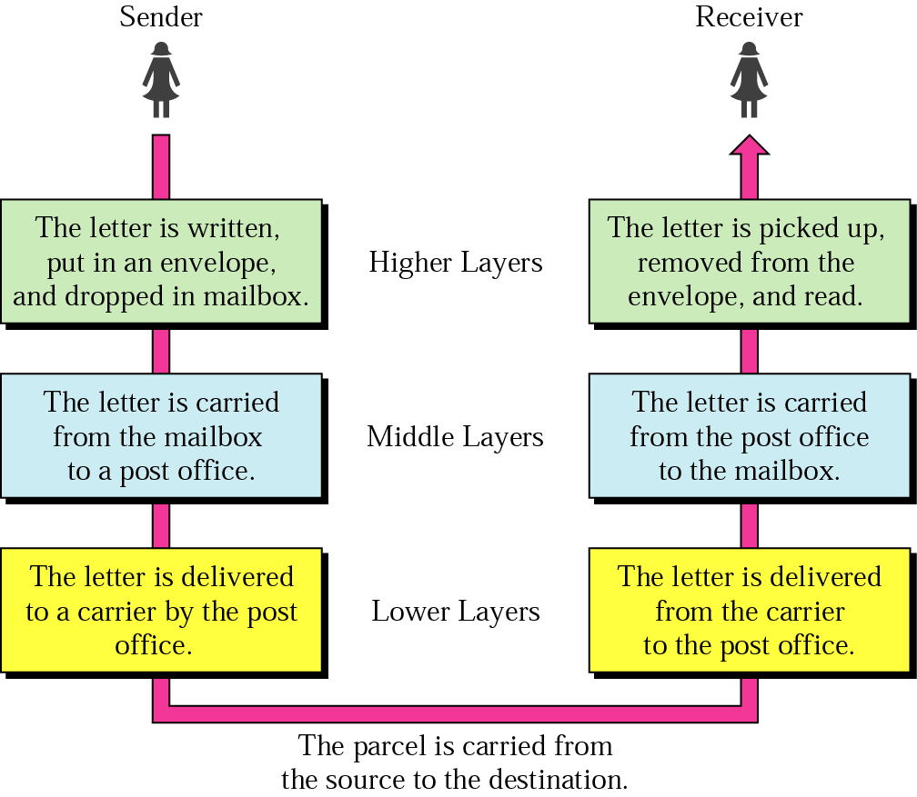
Layered Model: Sending a Letter
2-<number>

Slide 3

OSI Model
ISO is the organization. OSI is the model
2-<number>

Slide 4

Interaction between layers in the OSI model
Layer and interface
2-<number>

Slide 5

An exchange using the OSI model
Encapsulation with header and possibly trailer
2-<number>

Slide 6

Physical Layer
The physical layer is responsible for movements of individual bits from one hop (node) to the next
Mechanical and electrical specification, the procedures and functions
2-<number>

Slide 7
Physical Layer: Duties
Physical characteristics of interfaces and media
Representation of bits
Data rate
Synchronization of bits
Line configuration
Physical topology
Transmission mode
2-<number>

Slide 8

Data Link Layer
The data link layer is responsible for moving frames from one hop (node) to the next
Transform the physical layer to a reliable (error-free) link
2-<number>

Slide 9
Data Link Layer: Duties
Framing
Physical addressing
Flow control
Error control
Access control
2-<number>

Slide 10

Hop-to-Hop Delivery
2-<number>

Slide 11

Network Layer
The network layer is responsible for the delivery of packets from the source host to the destination host
2-<number>

Slide 12

Network Layer: Duties
Logical addressing and routing
2-<number>

Slide 13

Transport Layer
The transport layer is responsible for delivery of a message from one process to another
2-<number>

Slide 14
Transport Layer: Duties
Service-point (port) addressing
Segmentation and reassembly
Connection control
Flow control
Error control
2-<number>

Slide 15

Reliable Process-to-Process Delivery of a Message
2-<number>

Slide 16

Session Layer
Session layer is responsible for dialog control and synchronization
2-<number>

Slide 17

Presentation Layer
Presentation layer is responsible for translation, compression, and encryption
2-<number>

Slide 18

Application Layer
Application layer is responsible for providing services to the user
2-<number>

Slide 19
Application Layer: Services
Network virtual terminal
Mail services
File transfer, access, and management
Directory services
2-<number>

Slide 20

Summary of Layers
2-<number>

Slide 21

TCP/IP and OSI Model
2-<number>

Slide 22
TCP/IP Protocol Suite
Host-to-network : Physical and data link layer
  No specific protocol
Network layer
  IP(Internet Protocl), ARP(Address Resolution Protocol), RARP(Reverse ARP), ICMP(Internet Control Message Protocol), IGMO(Internet Group Message Protocol)
Transport layer
  TCP(Transmission Control Protocol), UDP(User Datagram Protocl), SCTP(Stream Control Transmission Protocol),
Application Layer
  Combined session, presentation, and application layers
2-<number>

Slide 23

Addressing
Four levels of addresses in TCP/IP protocols
Physical (link), logical (IP, network), port, and specific addresses
2-<number>

Slide 24

Relationship of Layers and Addresses
2-<number>

Slide 25

Physical Address
A node with physical address 10 sends a frame to a node with physical address 87. The two nodes are connected by a link (bus topology LAN). As the figure shows, the computer with physical address 10 is the sender, and the computer with physical address 87 is the receiver.
07:01:02:01:2C:4B
A 6-byte (12 hexadecimal digits) physical address.
2-<number>

Slide 26

Logical (IP) Address
The physical addresses will change from hop to hop, but the logical addresses usually remain the same
2-<number>

Slide 27

Port Address
The physical addresses change from hop to hop, but the logical and port addresses usually remain the same
2-<number>

Slide 28
Specific Address
Some application have user-friendly addresses that are designed for that specific address
Example 1: e-mail address: kchung@kw.ac.kr
  Defines the recipient of an e-mail
Example 2: URL (Universal Resource Locator) : www.kbs.co.kr
  Used to find a document on the WWW
2-<number>

